Slide 1
Machine Learning Assisted
Cyclic Coordinate Descent Algorithm
For Scalable Black-box Optimization
Muyi Song
Advisor:
Prof. Nikolaos V. Sahindis,
Dr. Jonggeol Na
Department of Chemical engineering
December 2, 2019
Notes:
Hi everyone, my name is Muyi Song. Today I’d like to share my Master project with you which is [Machine learning assisted cyclic coordinate descent algorithm for scalable black-box optimization]

Slide 2
Contents
Introduction and Motivation
Proposed Algorithm
Problem Statement
Results and Discussion
Conclusion
Notes:
I’m going to present my project in these five parts.
Introduction and motivation
Proposed algorithm
Problem statement
Results and discussions
Conclusions

Slide 3
Introduction and Motivation
Black-box optimization
Given a set of potential power plant layouts, how do we find the best layout defined against a set of quantities of interest?
Given a steam turbine, how do we configure its geometry to achieve the best efficiency?
Given design variables of a machine, how do we know its life? And how do they connect to the damage?
Lack of physical understanding
Unaffordable cost for modeling
Unknown noisy statistics
Input vector
?
Objective vector
Objective function
Notes:
At the beginning, let me introduce some basic background information to you.
So what is black-box optimization? For example, if a set of power plant layouts is given, how do we find the best layout in terms of capital investment? Actually we can find there are some common problems in these situations:
Lack of physical understanding of the model. We do know that layouts of industries are designed on purpose. Equipment tend to be built at downwind places for process safety. But we don’t know the relationship between layouts and benefits
The cost of evaluation is unaffordable.
Sometimes noisy statistics is obtained from experiments. But we don’t know where is it coming from.
All of the situations I referred above lead to an unknown objective function during optimization. Thus, we can only input a vector into black boxes and get an output value without any information of inner structures

Slide 4
Introduction and Motivation
Traditional optimization
A physical problem can be mathematically expressed as a function
Optimum solution (either minimum or maximum) of the objective function can be obtained using the concept of derivative
Common methods:
Random search method, pattern search method, etc
Gradient-based search
Black-box optimization
Unsolvable using conventional approaches (Inaccessible gradient information or truly unavailable functions)
Unaffordable cost of function evaluations (experimental or industrial situations)
Notes:
When we speak of traditional optimization problems, a mathematical expression of objective function is always available. Then what we need to do is to find the minimum or maximum under constraints. Several methods have been proved that they can solve traditional optimization problems efficiently and effectively.
But two major problems make black box optimization problems more complexed and unsolvable.
Firstly, gradient information is not accessible.
Secondly, function evaluations are always extremely expensive.
So how to find the optimal value within limited number of evaluations has become the primary goal for researchers.

Slide 5
Proposed Algorithm
Initialization
Tools
Sampling
ALAMO
Adaptive sampling
Quadratic based
Surrogate Modeling
Modification
Optimization
BARON
Mixed-Integer nonlinear optimization solver
Update
Termination
No
Yes
End
Notes:
This the flow chart showing the logic of my proposed algorithm. After initialization of starting point and the range of search, the algorithm is sampling a group of data points to build a surrogate model. ALAMO is implemented here to build the model, which accepts input data from the algorithm to build a surrogate model by using adaptive sampling technique repeatedly until convergence. In this project, quadratic based model is used. A mathematical expression of the model should be returned which will then be sent to BARON software which is a mixed-integer nonlinear optimization solver to get a local optimal solution. This process repeats until meeting the termination condition. Otherwise the range of search and number of sampling points should be modified to make a more accurate model in the next iteration

Slide 6
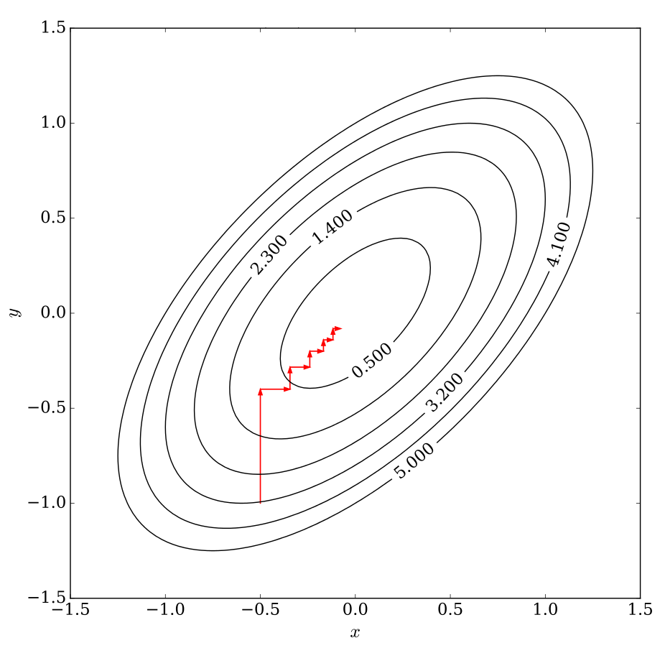
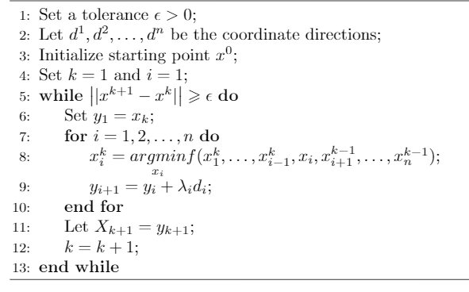
Proposed Algorithm
Cyclic Coordinate Descent – update scheme
Notes:
I used cyclic coordinate descent as searching algorithm. The main advantage is that it is very easily applied. And it is flexible to be integrated with other tools.
The simple process of cyclic coordinate search can be visualized like this figure. It changes a chosen coordinate at each iteration. Indices are selected cyclically. Regarding the update schemes, I simply renew by minimizing the objective with respect to the specific variable while fixing the others.

Slide 7
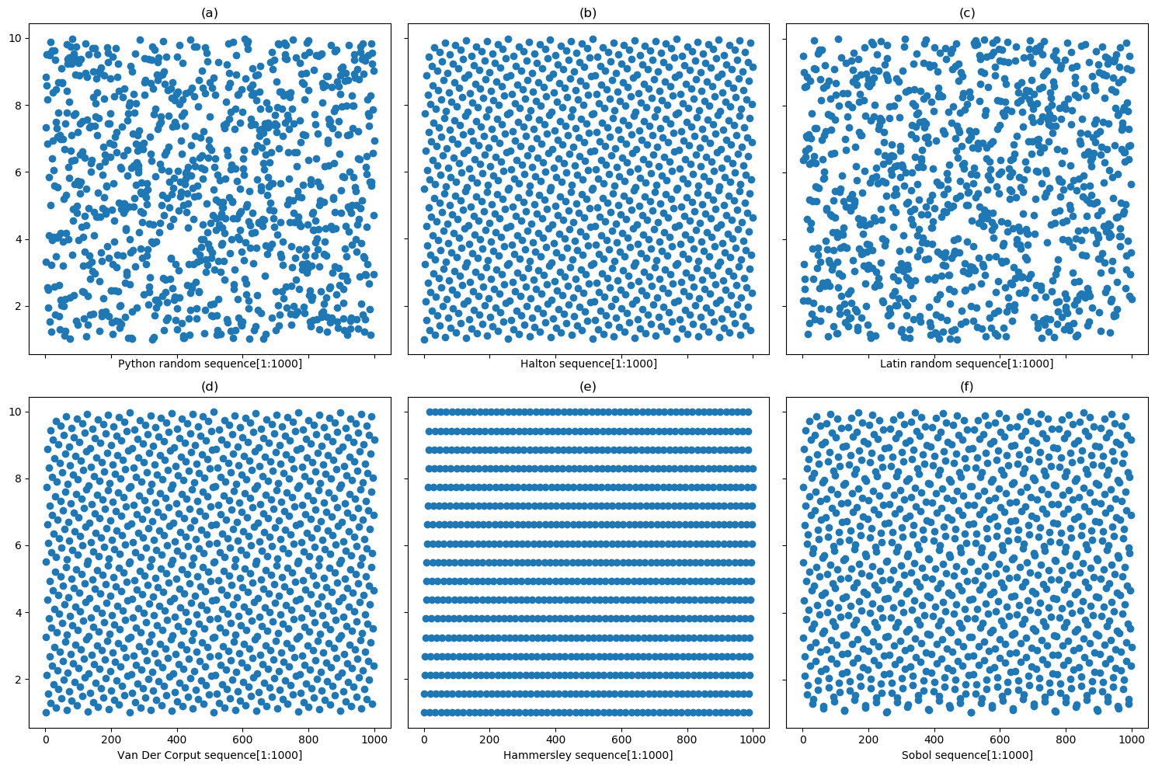
Proposed Algorithm
Sampling Methods
Python random | Halton sequence | Latin square
Van Der Corput sequence | Hammersly sequence | Sobol sequence
Notes:
Another problem is if we can build a accurate surrogate model with limited sampling point, which requires each point is able to make a contribution. Intuitively, I’d like to test the performances of different sampling methods. The first image is generated by python random library. You can see that points are actually not distributed evenly in local space. In comparison, four types of quasi-random sequences are selected including Halton, Van Der Corput, Hammersley and Sobol sequences. Another sampling method is Latin random square.

Slide 8
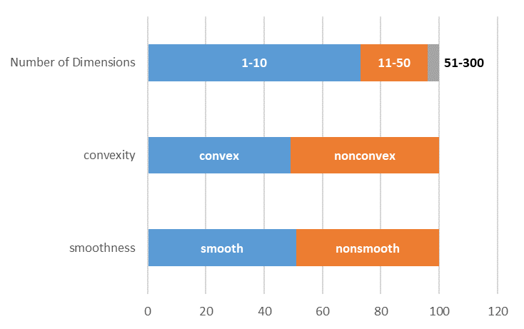
Problem Statement
100 Black box models
Variables | smoothness |  | Convexity |  | total
 | Smooth | Nonsmooth | Convex | Nonconvex
1-10 | 36 | 37 | 28 | 45 | 73
10-50 | 11 | 12 | 18 | 5 | 23
50-300 | 4 | 0 | 3 | 1 | 4
Notes:
100 black box models were chosen from multiple libraries with different smoothness, convexity and number of variables. This information is provided.

Slide 9
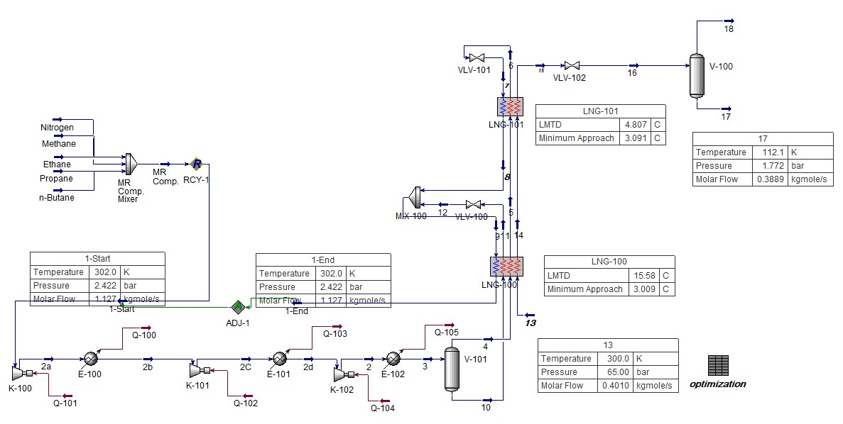
Problem Statement
The Single Mixed Refrigerant Liquefaction Process Simulation
Component | Lower bound | Upper bound
Nitrogen | 0.859 | 16.321
Methane | 2.597 | 49.343
Ethane | 2.541 | 48.279
N-Butane | dependent
Equipment | Amount
Multi-stream heat exchanger | 2
Phase separator | 1
Compressor | 3
After-cooling Heat exchanger | 1
Notes:
A realistic industrial case is selected as well. We know that process system simulation has been applied in chemical engineering in terms of efficiency and economic feasibility. But inner structures of software like Aspen is unavailable for users like black boxes. The single mixed refrigerant liquefaction process is one of the most famous technique for offshore natural gas fields development. In this project, the algorithm was trying to optimize a base case aiming to find the best configuration.

Slide 10
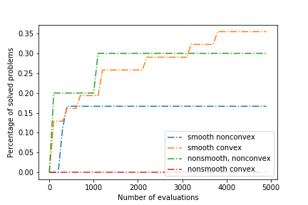
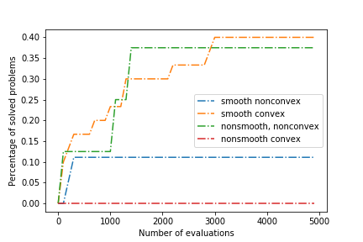
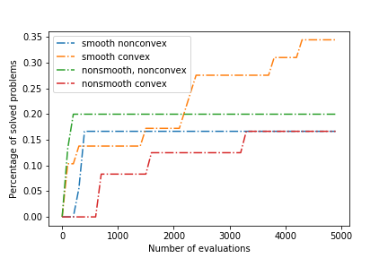
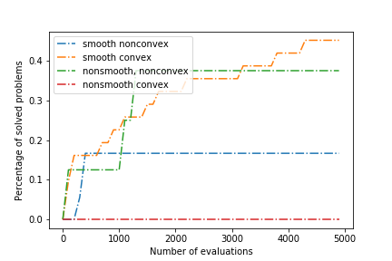
Results and Discussion
Percentage of solved problems v.s. Number of evaluations
Halton
Hammersley
Van Der Corput
Unable to solve nonsmooth-convex problems
More evaluations are helpful for smooth-convex and nonsmooth-nonconvex problems
Latin
Sobol
Notes:
These summary plots shows how many test problems have been solved by proposed algorithm with a specific number of evaluations with different sampling methods.
From the figures we can find that the proposed algorithm shows poor ability of solving nonsmooth-convex problems. With increasing evaluations, better solutions were obtained for smooth-convex and some nonsmooth-nonconvex problems which are represented by yellow and green lines.
Although it seems like there is no big difference between them, we can still find that Sobol sequence has shown the fastest speed of convergence among all of the methods, and Latin random square proved that it can solve a proportion of the problems consistently regardless of smoothness and convexity.

Slide 11
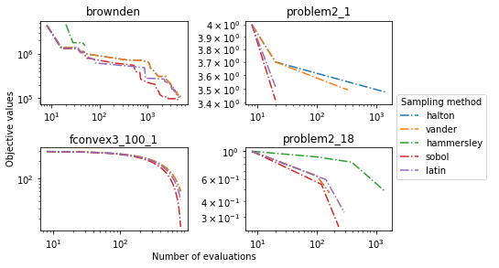
Results and Discussion
Observations:
Better performance in smooth models
Tend to be stuck in local optimal points in nonsmooth models
Global optimal can be expected for smooth-convex models
Discussions:
Difference performances of quasi-random sequence sampling
Impact from smoothness and convexity
Potential reasons:
Halton, Hammersley are mainly designed for higher dimensions deriving from Van Der Corput
Sobol has better distribution with base 2 radical inversion
smooth-nonconvex
nonsmooth-convex
smooth-convex
nonsmooth-nonconvex
Notes:
The plots on the left hand side show the whole process of convergence for some typical problems.
We can see that an obvious convergence process can be observed in smooth-nonconvex and smooth-convex problems. I set a limitation for the number of evaluations. But if more evaluations were given, the global optimal points can be expected for smooth models. On the contrary, the algorithm tends to be stuck in local optimal points in nonsmooth models.
Difference between sampling methods can be found in the plots, which is not so obvious. Because we focused on single dimension modeling and some methods are designed for higher dimensions like Halton, Hammersley and Latin random square. Halton and Hammersley derived from Van Der Corput sequence which is one of the most classical low discrepancy sequences generated from radical inversion. In comparison, Sobol sequence not only has a good distribution over the sampling space, but also it shows high-qualified sampling performance when the number of points equals integer power of two.

Slide 12
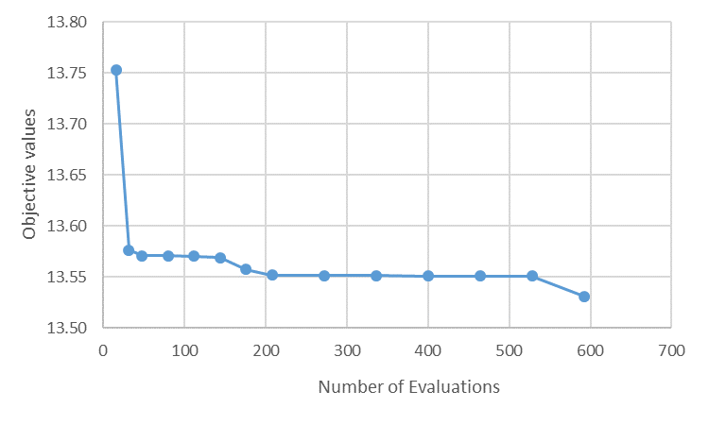
Results and Discussion
SMR liquefaction process simulation result
Fail to optimize the SMR simulator
Discussions:
Discontinuous hidden constraints
Pre-defined constraints from relationship between variables based on physical configuration
Potential solutions:
Search globally
Block coordinate search
Notes:
Then I applied the proposed algorithm on the SMR simulation. However, I found the search progress was kept being stuck after hundreds of evaluations and cannot find the global optimal solution. I looked into the source code and some paper trying to find out the reasons.
There is a big difference between SMR simulation and previous black box models. Discontinuous hidden constraints and pre-defined constraints coming from physical configuration of the technique have been assumed. An extreme big number should be returned as long as those constraints are violated. In this situation, our algorithm did not perform well with the existence of those noisy data points. It cannot capture the pattern with surrogate modeling. And the range of search was adjusted based on the accuracy of last iteration’s modeling. Consequently, the algorithm tends to be stuck at the local optimal when the space has many infeasible solutions.
These problems may possibly be solved with the application of global search. We can sample data from the whole range of model and filter the infeasible points out. Block coordinate search method is another potential solution to correlated variables which update multiple components simultaneously in each iteration.

Slide 13
Conclusions
Surrogate modeling has been proved that it is a flexible and useful method in black-box optimization problems
Different sampling methods has shown different performances depending on smoothness, convexity and the dimensions of surrogate model
Sobol sequence currently has the best solutions combining with cyclic coordinate search algorithm
Proposed algorithm is not able to solve problems with discontinuous hidden constraints and linked variables deriving from industrial problem; global sampling and block coordinate search probably are expected to be applied
Notes:
This project is mainly focusing on implementing an existed algorithm and tools, and test their performances with different combinations. Although I did not get perfect results at the end, several conclusions can be drawn based on my experiments.
1. Surrogate modeling has been proved that it is a flexible and useful method to catch the shape of the black boxes
2. Different sampling methods has shown different performances depending on the properties of the models
3. Sobol sequence has shown the best performance yet combing with cyclic coordinate descent and 1-d modeling
4. Proposed algorithm is not able to solve the problems with discontinuous hidden constraints and correlated variables. More techniques are expected to be applied in the future

Slide 14
Question and Answer
Notes:
Thanks for listening. So, any questions?

